Slide 1


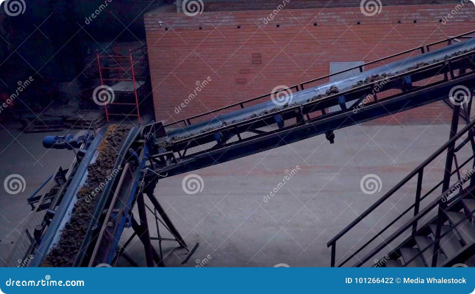
Introduction to Predictive Maintenance with Chatbot Integration
Maintaining the reliability and efficiency of critical equipment like conveyor belt systems in power plants is essential for consistent electricity production. Conventional maintenance approaches often rely on reactive, time-based, or preventive strategies that can be costly and inefficient. However, the integration of predictive maintenance techniques powered by synthetic sensor data and an intelligent chatbot interface can revolutionize the way power plants approach equipment maintenance. This presentation will explore how this innovative solution can help power plant operators detect anomalies early, optimize maintenance schedules, and minimize unplanned downtime, ultimately leading to significant cost savings and operational benefits.

Slide 2
Importance of Conveyor Belt Systems in Power Plants
Backbone of Power Generation
Operational Efficiency
Cost Implications
The efficient operation of conveyor belt systems directly impacts the overall productivity and output of power plants. Any disruption or downtime in these systems can lead to significant production losses, making their maintenance a top priority for plant managers.
The cost of repairing or replacing a malfunctioning conveyor belt system can be exorbitant, often running into millions of dollars. Unplanned downtime can also result in lost revenue and additional expenses, underscoring the need for proactive maintenance strategies.
Conveyor belt systems play a crucial role in power plants, responsible for transporting essential materials such as coal, ash, and raw materials to and from various processes. These systems act as the backbone, ensuring a seamless and continuous flow of resources necessary for electricity generation.

Slide 3


Challenges with Conventional Maintenance Approaches
1
Reactive Maintenance
2
Time-Based Maintenance
Waiting for equipment to fail before addressing issues can lead to unplanned downtime, increased repair costs, and potential safety hazards.
Performing maintenance at fixed intervals, regardless of the actual condition of the equipment, can result in unnecessary maintenance activities and wasted resources.
3
Preventive Maintenance Limitations
4
Lack of Real-Time Monitoring
While preventive maintenance can help reduce breakdowns, it often fails to account for the unique operational conditions and wear patterns of individual components.
Relying on manual inspections and periodic checks can make it challenging to detect early signs of deterioration or impending failures.

Slide 4

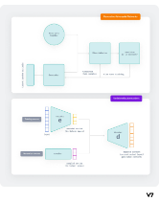
Synthetic Data: Overcoming Real Sensor Limitations
Addressing Sensor Gaps
Simulating Failure Modes
In power plants, critical equipment like conveyor belt systems may not always have a comprehensive network of sensors installed. Synthetic data generation can help fill these gaps, providing the necessary data points to enable more accurate predictive maintenance models.
By creating synthetic data that mimics various failure scenarios, maintenance teams can train their predictive algorithms to better detect anomalies and anticipate potential breakdowns, even in the absence of real-world failure data.
Enhancing Model Robustness
Cost-Effective Solution
Integrating synthetic data with real sensor data can help improve the accuracy and reliability of predictive maintenance algorithms, ensuring they can adapt to a wider range of operating conditions and equipment behavior.
Generating synthetic data is often more cost-effective than deploying additional sensors, making it a practical solution for power plants seeking to enhance their predictive maintenance capabilities without significant hardware investments.

Slide 5



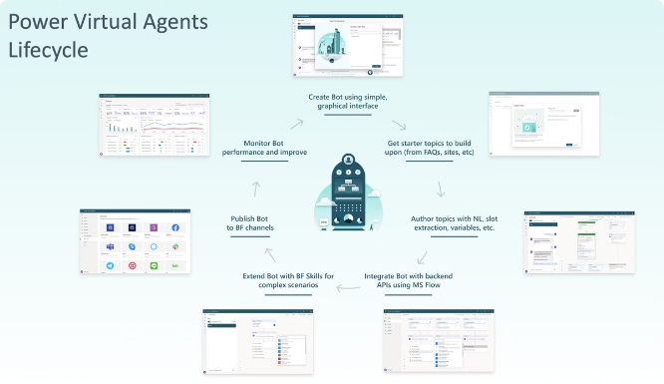


Chatbot Integration: Enhancing Maintenance Efficiency
Proactive Alerts
Data-Driven Insights
The chatbot can provide real-time notifications to maintenance teams, alerting them to potential issues or impending failures detected by the predictive maintenance algorithms.
The chatbot can present maintenance personnel with relevant data, analytics, and recommendations to help them make informed decisions and optimize maintenance strategies.
Automated Workflows
Seamless Collaboration
The chatbot can automate various maintenance-related tasks, such as generating work orders, scheduling maintenance activities, and tracking the progress of ongoing repairs.
The chatbot can serve as a centralized communication hub, allowing maintenance teams, plant operators, and other stakeholders to collaborate more effectively and address issues promptly.

Slide 6

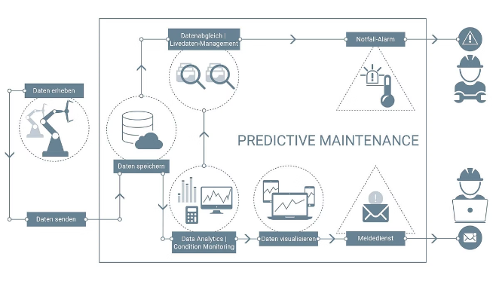
Predictive Maintenance Algorithm: Detecting Anomalies
1
Data Collection
The predictive maintenance algorithm starts by gathering data from various sources, including synthetic data, real-time sensor readings, and historical maintenance records.
2
Feature Engineering
The algorithm then processes the collected data, identifying relevant features and indicators that can be used to detect anomalies and predict potential failures.
3
Anomaly Detection
The algorithm analyzes the processed data, applying advanced machine learning techniques to identify patterns and detect any deviations from normal operating conditions, which could signal an impending issue.

Slide 7
Chatbot Interface: Seamless User Experience
Intuitive Interaction
Personalized Recommendations
Contextual Awareness
The chatbot interface is designed to be user-friendly, allowing maintenance personnel to interact with it using natural language and receive responses in a conversational format, minimizing the learning curve and enhancing overall efficiency.
The chatbot is equipped with a deep understanding of the power plant's maintenance processes, equipment specifications, and operational constraints, enabling it to provide context-specific guidance and support to the maintenance team.
The chatbot can leverage the insights from the predictive maintenance algorithm to provide personalized recommendations and maintenance suggestions tailored to the specific needs and operating conditions of the power plant's conveyor belt system.

Slide 8

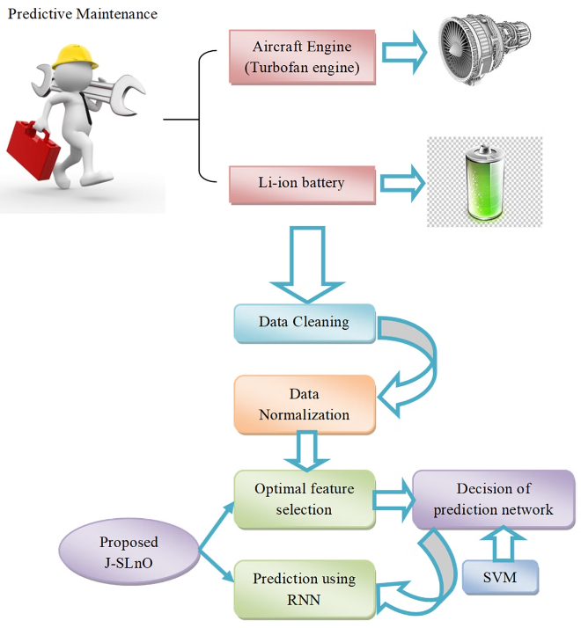



Pilot Study: Deployment and Validation
Deployment
The predictive maintenance solution, including the chatbot interface, is deployed in a pilot power plant, integrating with the existing conveyor belt system and monitoring its performance.
Data Collection
During the pilot, the system continues to collect and analyze data from both real-time sensors and the synthetic data sources, refining the predictive maintenance algorithms and the chatbot's capabilities.
Validation
The performance and effectiveness of the predictive maintenance solution are closely monitored and validated against the plant's maintenance records, operational metrics, and feedback from the maintenance team.

Slide 9
Cost Savings and Operational Benefits
Reduced Maintenance Costs
Improved Productivity
Enhanced Safety
The predictive maintenance approach, coupled with the chatbot's automation and optimization capabilities, can help power plants significantly reduce the costs associated with unplanned downtime, unnecessary maintenance, and expensive equipment repairs or replacements.
By proactively addressing potential issues and optimizing maintenance schedules, the predictive maintenance solution can help power plants maintain higher levels of equipment availability and operational efficiency, leading to increased electricity production and revenue.
The early detection of anomalies and timely maintenance interventions enabled by the predictive maintenance system can help power plants mitigate safety risks, protect their workforce, and avoid costly accidents or environmental incidents.

Slide 10


Conclusion and Future Considerations
Embracing Innovation
Continuous Improvement
The integration of predictive maintenance techniques and chatbot technology represents a significant step forward in enhancing the reliability and efficiency of critical equipment in power plants. As the industry continues to evolve, embracing such innovative solutions will be crucial for power plant operators to stay competitive and meet the growing demand for reliable electricity generation.
The predictive maintenance solution presented in this proposal is designed to be a living, adaptable system that can continue to learn and improve over time. As more data is collected and analyzed, the algorithms can be refined, and the chatbot's capabilities can be expanded to provide even greater value to power plant maintenance teams.
Future Integrations
Looking ahead, there is potential to integrate the predictive maintenance platform with other advanced technologies, such as augmented reality, digital twins, and IoT-enabled sensors, further enhancing the maintenance team's ability to visualize, diagnose, and address equipment issues in real-time.

